Slide 1
Introduction to Data Analysis

Slide 2
STATISTICAL LEARNING
Patrick Boily Data Action Lab | uOttawa | Idlewyld Analytics
[with files from Jen Schellinck | Sysabee]

Slide 3
LEARNING CONTEXTS
STATISTICAL LEARNING
“We learn from failure, not from success!”
(Bram Stoker, Dracula)

Slide 4

TYPES OF LEARNING
The central Data Science/Machine Learning problem is:
can (should) we design algorithms that can learn?
Supervised Learning (learning with a teacher)
classification, regression, rankings, recommendations
uses labeled training data (student gives an answer to each test question based on what they learned from worked-out examples)
performance is evaluated using testing data (teacher provides the correct answers)
a target exists against which to train the model

Slide 5
TYPES OF LEARNING
Unsupervised Learning (grouping similar exercises together as a study aid)
clustering, association rules discovery, link profiling, anomaly detection
uses unlabeled observations (teacher is not involved)
accuracy cannot be evaluated (students might not end up with the same groupings)
the concept of a target is not applicable
Others:
semi-supervised learning (teacher providing worked-out examples and a list of unsolved problems)
reinforcement learning (embarking on a Ph.D. with an advisor?)

Slide 6
Association Rules
STATISTICAL LEARNING
MR. SNIFF: What are you looking for? MR. SNOOP: A five-dollar bill. MR. SNIFF: Are you sure you lost it on this street? MR. SNOOP: Oh no! I lost it in the next block, but I’m lookin’ up here because the light is better.
(Boys’ Life Magazine, 1932)

Slide 7
ASSOCIATION RULES BASICS
Association Rule Discovery is a type of unsupervised learning that finds connections among attributes (and combinations of attributes).
Examples:
bread and milk are often purchased together… is that interesting?
hot dogs and mustard are also often purchased as a pair, but more rarely purchased individually… is that interesting?
A supermarket could then have a sale on hot dogs to drive in customers, while raising the price on condiments, to maintain profit margins.

Slide 8
APPLICATIONS
Related Concepts
looking for pairs (triplets, etc) of words that represent a joint concept
{Ottawa, Senators}, {Michelle, Obama}, {veni, vidi, vici}, etc.
Plagiarism
looking for sentences that appear in various documents
looking for documents that share sentences
Bio-markers
diseases that are frequently associated with a set of bio-markers

Slide 9
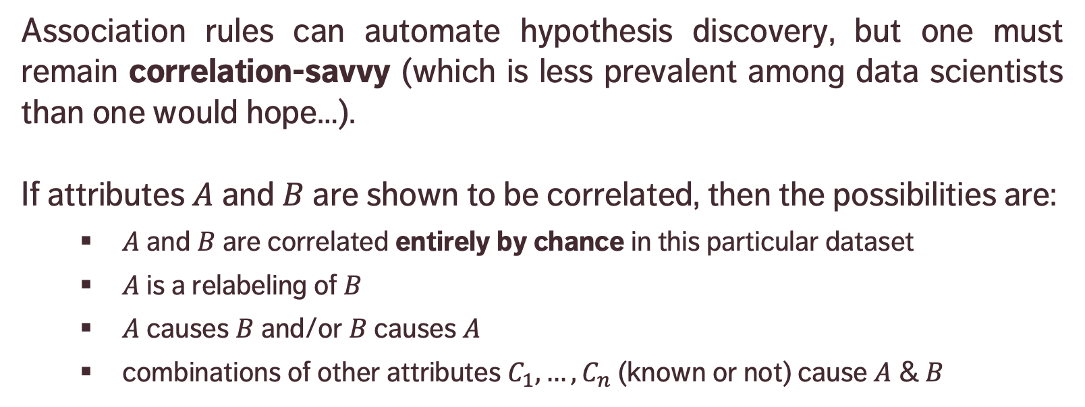
CAUSATION AND CORRELATION
Association rules can automate hypothesis discovery, but one must remain correlation-savvy (which is less prevalent among data scientists than one would hope…).
If attributes $A$ and $B$ are shown to be correlated, then the possibilities are:
$A$ and $B$ are correlated entirely by chance in this particular dataset
$A$ is a relabeling of $B$
$A$ causes $B$ and/or $B$ causes $A$
combinations of other attributes $C_{1},…,C_{n}$ (known or not) cause $A$ & $B$

Slide 10
CAUSATION AND CORRELATION
[E. Siegel, Predictive Analytics: The Power to Predict Who Will Click, Buy, Lie, or Die]
Insight | Organization
Pop-Tarts before a hurricane | Walmart
Higher crime, more Uber rides | Uber
Typing with proper capitalization indicates creditworthiness | A financial services startup company
Users of the Chrome and Firefox browsers make better employees | A human resources professional services firm, over employee data from Xerox and other firms
Men who skip breakfast get more coronary heart disease | Harvard University medical researchers
More engaged employees have fewer accidents | Shell
Smart people like curly fries | Researchers at the University of Cambridge and Microsoft Research
Female-named hurricanes are more deadly | University researchers
Higher status, less polite | Researchers examining Wikipedia behavior

Slide 11
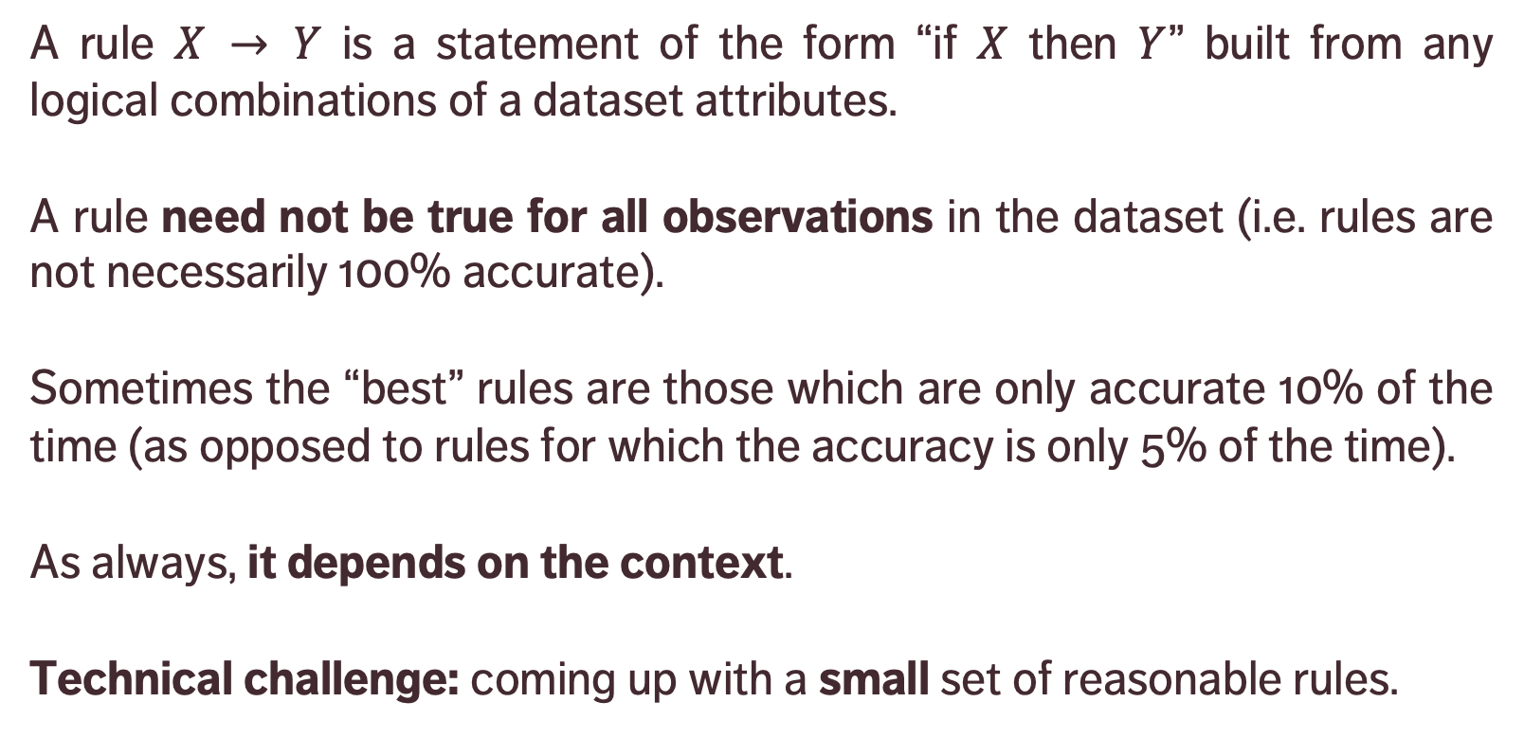
DEFINITIONS
premise
conclusion
A rule $X → Y$ is a statement of the form “if $X$ then $Y$” built from any logical combinations of a dataset attributes.
A rule need not be true for all observations in the dataset (i.e. rules are not necessarily 100% accurate).
Sometimes the “best” rules are those which are only accurate 10% of the time (as opposed to rules for which the accuracy is only 5% of the time).
As always, it depends on the context.
Technical challenge: coming up with a small set of reasonable rules.

Slide 12
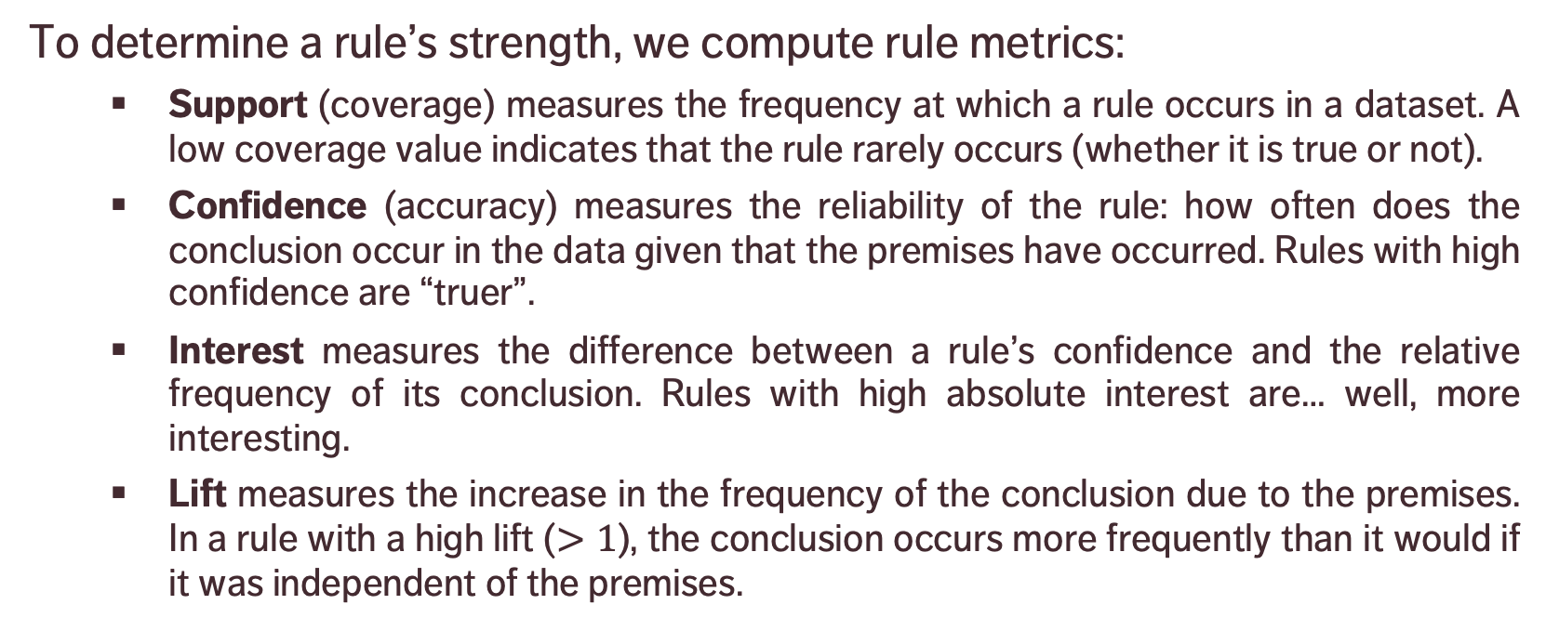
DEFINITIONS
To determine a rule’s strength, we compute rule metrics:
Support (coverage) measures the frequency at which a rule occurs in a dataset. A low coverage value indicates that the rule rarely occurs (whether it is true or not).
Confidence (accuracy) measures the reliability of the rule: how often does the conclusion occur in the data given that the premises have occurred. Rules with high confidence are “truer”.
Interest measures the difference between a rule’s confidence and the relative frequency of its conclusion. Rules with high absolute interest are… well, more interesting.
Lift measures the increase in the frequency of the conclusion due to the premises. In a rule with a high lift ($>1$), the conclusion occurs more frequently than it would if it was independent of the premises.

Slide 13
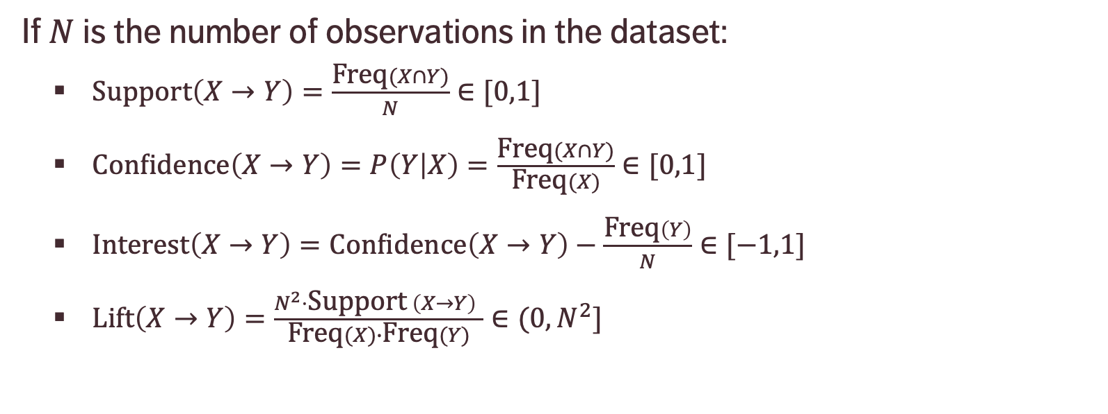
FORMULAS
If $N$ is the number of observations in the dataset:
$\text{Support}\left(X→Y\right)=\frac{\text{Freq}(X∩Y)}{N}∈[0,1]$
$\text{Confidence}\left(X→Y\right)=P\left(Y | X\right)=\frac{\text{Freq}(X∩Y)}{\text{Freq}(X)}∈[0,1]$
$\text{Interest}\left(X→Y\right)=\text{Confidence}\left(X→Y\right)−\frac{\text{Freq}\left(Y\right)}{N}∈[−1,1]$
$\text{Lift}\left(X→Y\right)=\frac{N^{2}⋅\text{Support} \left(X→Y\right) }{\text{Freq}(X)∙\text{Freq}(Y)}∈(0,N^{2}]$
Proportion of instances where the premise and the conclusion occur together
Proportion of instances where the conclusion occurs when the premise occurs
… ?!?

Slide 14
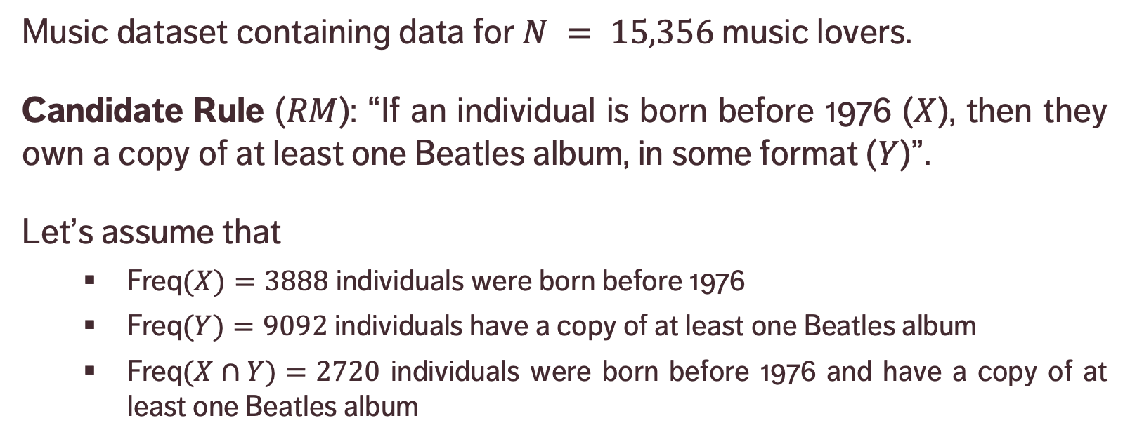
EXAMPLE
Music dataset containing data for $N = 15,356$ music lovers.
Candidate Rule ($RM$): “If an individual is born before 1976 ($X$), then they own a copy of at least one Beatles album, in some format ($Y$)”.
Let’s assume that
$\text{Freq}(X)=3888$individuals were born before 1976
$\text{Freq}(Y)=9092$ individuals have a copy of at least one Beatles album
$\text{Freq}(X∩Y)=2720$ individuals were born before 1976 and have a copy of at least one Beatles album
Notes:
Lift: 70% of those who were born before 1976 own a copy, whereas 56% of those who were born after 1976 own a copy – there is a difference, but it is not large).

Slide 15
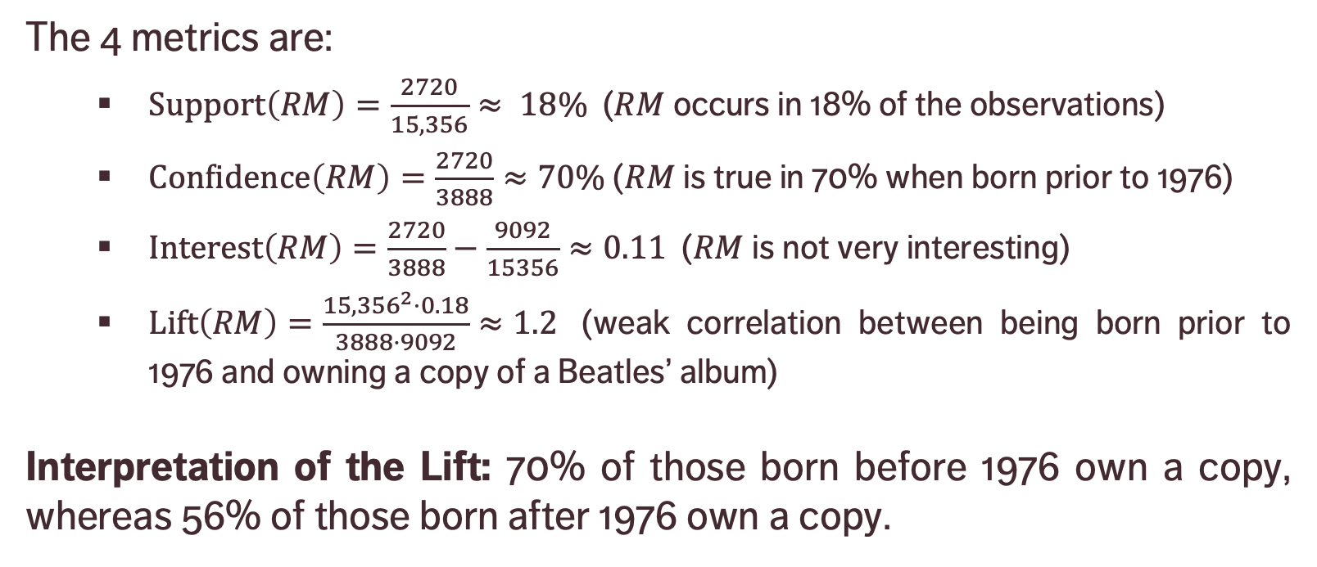
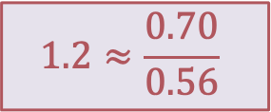
EXAMPLE
$$1.2≈\frac{0.70}{0.56}$$
The 4 metrics are:
$\text{Support}\left(RM\right)=\frac{2720}{15,356}≈ 18\%$ ($RM$ occurs in 18% of the observations)
$\text{Confidence}\left(RM\right)=\frac{2720}{3888}≈70\%$ ($RM$ is true in 70% when born prior to 1976)
$\text{Interest}\left(RM\right)=\frac{2720}{3888}−\frac{9092}{15356}≈0.11$ ($RM$ is not very interesting)
$\text{Lift}\left(RM\right)=\frac{{15,356}^{2}⋅0.18}{3888⋅9092}≈1.2$ (weak correlation between being born prior to 1976 and owning a copy of a Beatles’ album)
Interpretation of the Lift: 70% of those born before 1976 own a copy, whereas 56% of those born after 1976 own a copy.

Slide 16
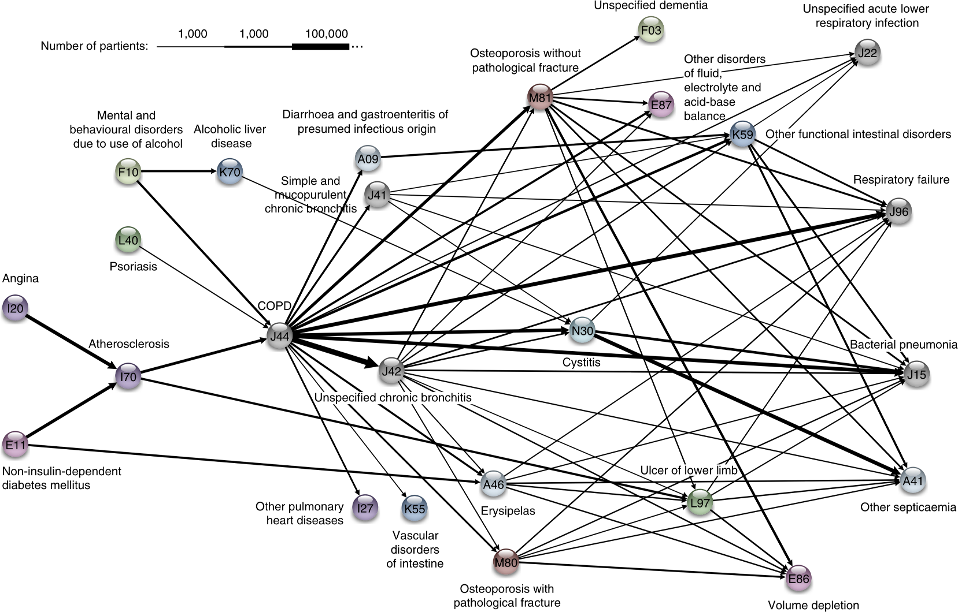
1,000 10,000 100,000
Jensen, A.B., Moseley, P.L., Oprea, T.I., Ellesøe, S.G., Eriksson, R., Schmock, H., Jensen, P.B., Jensen, L.J., Brunak, S. [2014], Nature Communications

Slide 17
CLASSIFICATION
STATISTICAL LEARNING
“Data science does not replace statistical modeling and data analysis; it augments them.”
(P. Boily)

Slide 18
CLASSIFICATION OVERVIEW
In classification, a sample set of data (the training set) is used to determine rules and patterns that divide the data into pre-determined groups, or classes (supervised learning; predictive analytics).
The training data usually consists of a randomly selected subset of the labeled (target) data.
Value estimation (regression) is akin to classification when the target variable is numerical.

Slide 19
CLASSIFICATION OVERVIEW
In the testing phase, the model is used to assign a class to observations for which the label is hidden, but ultimately known (the testing set).
The performance of a classification model is evaluated on the testing set, never on the training set.
Technical issues include:
selecting the features to include in the model
selecting the algorithm
etc.

Slide 20
APPLICATIONS
Medicine and Health Science
predicting which patient is at risk of suffering a second, fatal heart attack within 30 days based on health factors (blood pressure, age, sinus problems, etc.)
Social Policies
predicting the likelihood of requiring assisting housing in old age based on demographic information/survey answers
Marketing and Business
predicting which customers are likely to switch to another cell phone company based on demographics and usage

Slide 21
CLASSIFICATION METHODS
Logistic Regression
Neural Networks
Decision Trees
Naïve Bayes Classifiers
Support Vector Machines
Nearest Neighbours Classifiers
etc.
Age
Margin
Balance

Slide 22
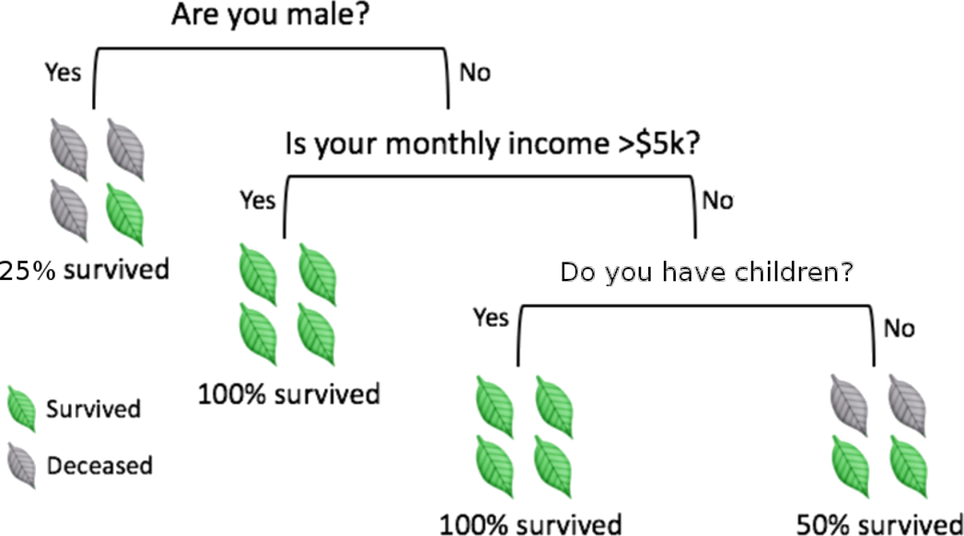
DECISION TREES
[adapted from A. Ng, K. Soo, Numsense!, Surviving a Disaster]
Decision trees are perhaps the most intuitive of these methods.
Classification is achieved by following a path up the tree, from its root, through its branches, and ending at its leaves.

Slide 23
OTHER POINTS TO PONDER
Classification is linked to probability estimation
approaches based on regression models could prove fruitful
Rare occurrences (often more interesting/important) continue to plague classification attempts
historical data at Fukushima's nuclear reactor prior to the meltdown could not have been used to learn about meltdowns
No Free-Lunch Theorem: no classifier works best for all data.
With big datasets, algorithms must also consider efficiency.

Slide 24
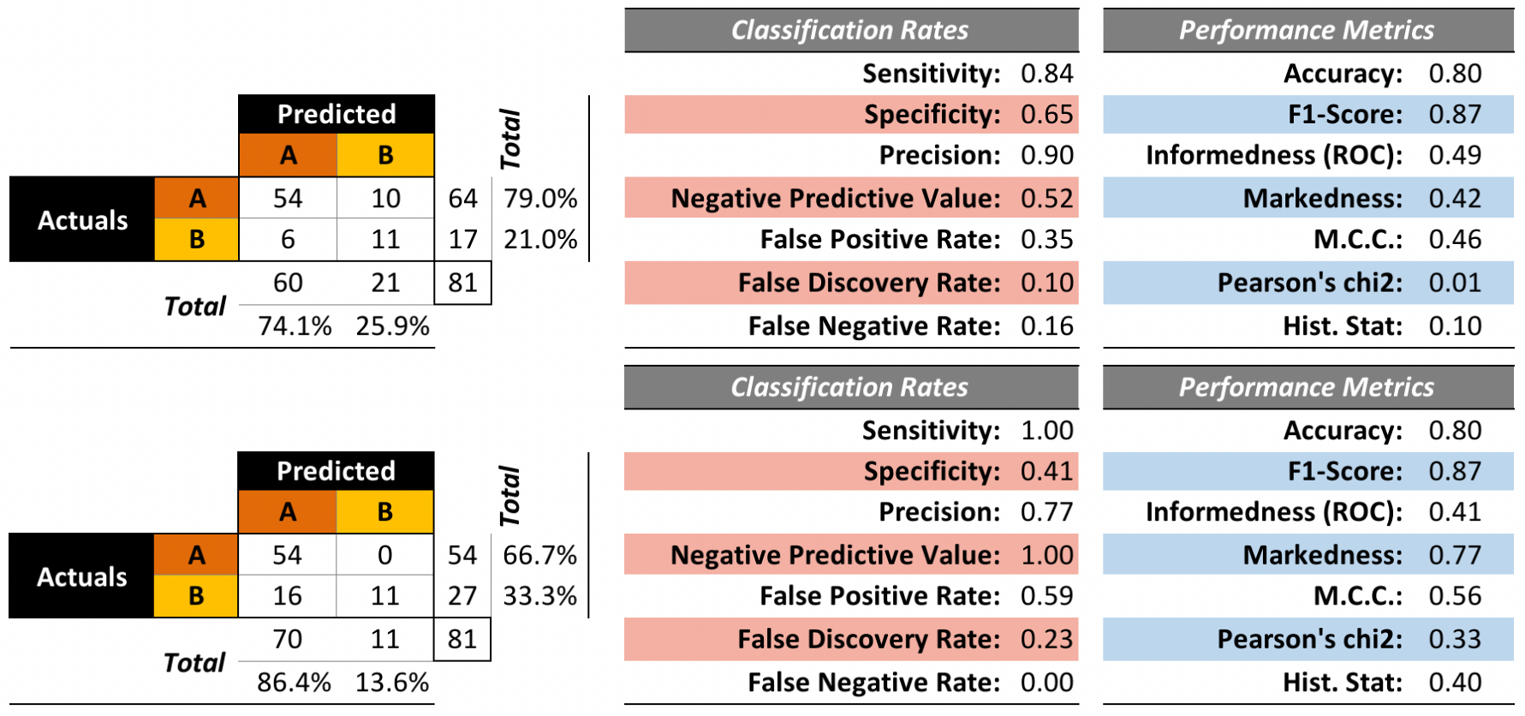
PERFORMANCE EVALUATION

Slide 25
CLUSTERING
STATISTICAL LEARNING
“Data is not information, information is not knowledge, knowledge is not understanding, understanding is not wisdom.”
(C. Stoll)

Slide 26
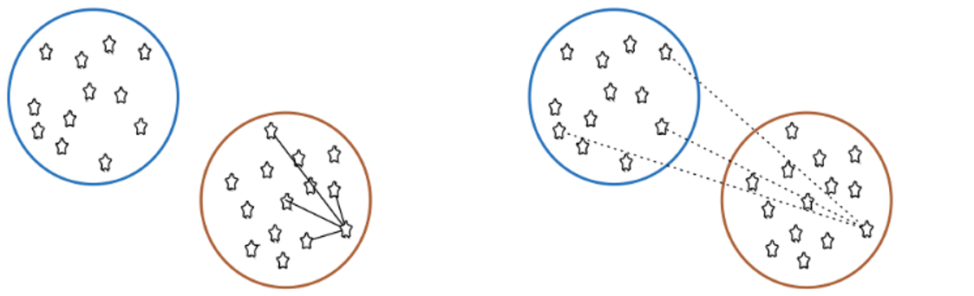
CLUSTERING OVERVIEW
In clustering, the data is divided into naturally occurring groups. Within each group, the data points are similar; from group to group, they are dissimilar.
average distance to points in own cluster (low is good)
average distance to points in neighbouring cluster (high is good)
The grouping labels are not determined ahead of time, so clustering is an example of unsupervised learning.

Slide 27
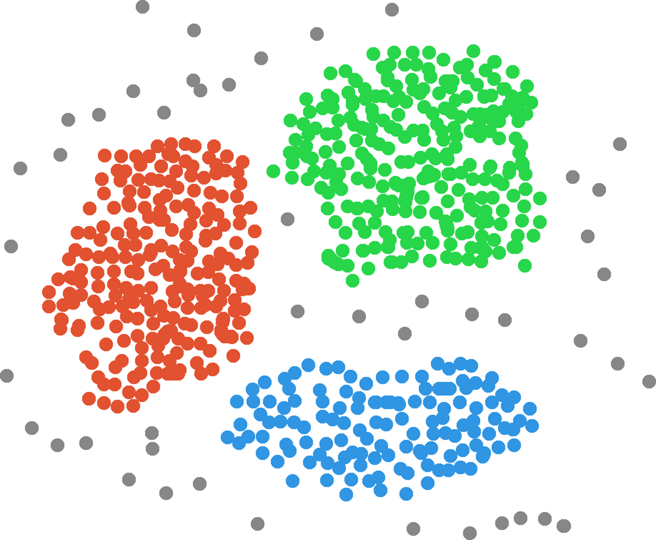
Income
Customers
Clusters
Age

Slide 28
APPLICATIONS
Text Documents
grouping similar documents according to their topics, based on the patterns of common and unusual words
Product Recommendations
grouping online purchasers based on the products they have viewed, purchased, liked, or disliked
grouping products based on customer reviews
Marketing and Business
grouping client profiles based on their demographics and preferences

Slide 29
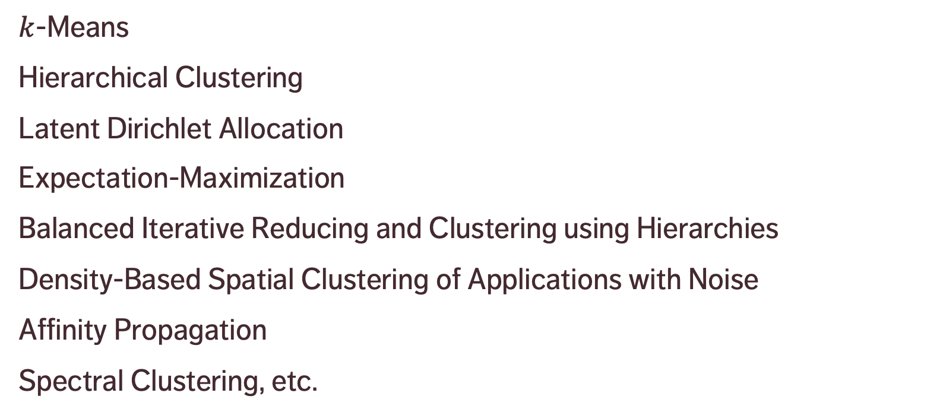
CLUSTERING METHODS
$k$-Means
Hierarchical Clustering
Latent Dirichlet Allocation
Expectation-Maximization
Balanced Iterative Reducing and Clustering using Hierarchies
Density-Based Spatial Clustering of Applications with Noise
Affinity Propagation
Spectral Clustering, etc.

Slide 30
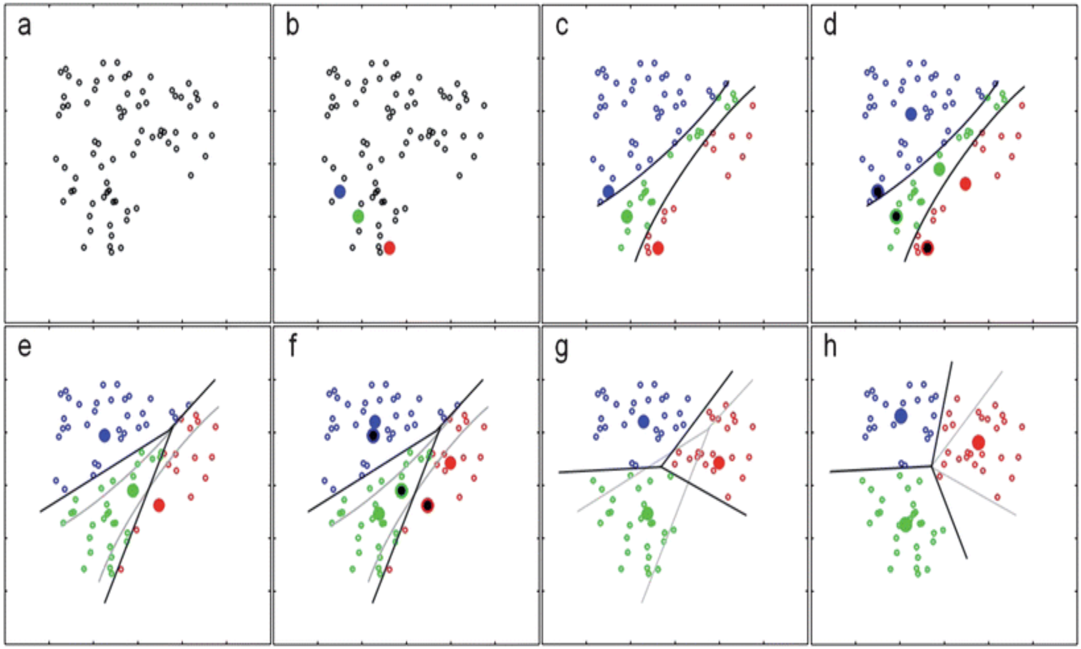
[https://notebook.community/alanhdu/AccessibleML/4. K-means clustering and unsupervised learning]

Slide 31
CLUSTERING CHALLENGES
Automation
Lack of a clear-cut definition
Lack of repeatability
Number of clusters
Cluster description
Validation
Ghost clustering
A posteriori rationalization

Slide 32
ISSUES & CHALLENGES
STATISTICAL LEARNING
“We all say we like data, but we don’t. We like getting insight out of data. That’s not quite the same as liking data itself. In fact, I dare say that I don’t quite care for data, and it sounds like I’m not alone.”
(Q.E. McCallum, Bad Data Handbook)

Slide 33
BAD DATA
Does the dataset pass the smell test? (invalid entries, etc.)
Detecting lies and mistakes (reporting errors, use of polarizing language)
Is close enough, good enough?
Sources of bias and errors
Seeking perfection (academic, professional, government, service data)
Data science pitfalls: analysis without understanding, using only one tool (by choice/fiat), analysis for the sake of analysis, unrealistic expectations of data science, it’s on a need-to-know basis and you don’t need to know.

Slide 34
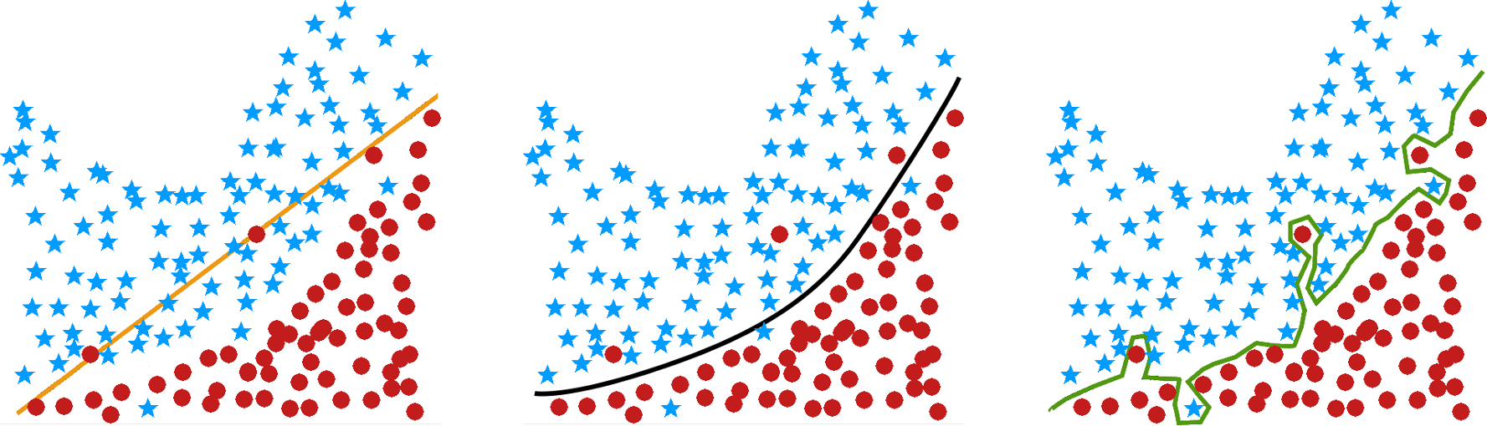
OVERFITTING
underfit
just right
overfit

Slide 35
BIG DATA VS. SMALL DATA
What is the main difference?
datasets are LARGE
issues: collection, capture, access, storage, analysis, visualization
Where does the data come from?
technology advances are lifting the limits on data processing speeds
information-sensing, mobile devices, cameras and wireless networks
What are the challenges?
most techniques were built for very small dataset
direct approach will leave the best analyst waiting years for results

Slide 36
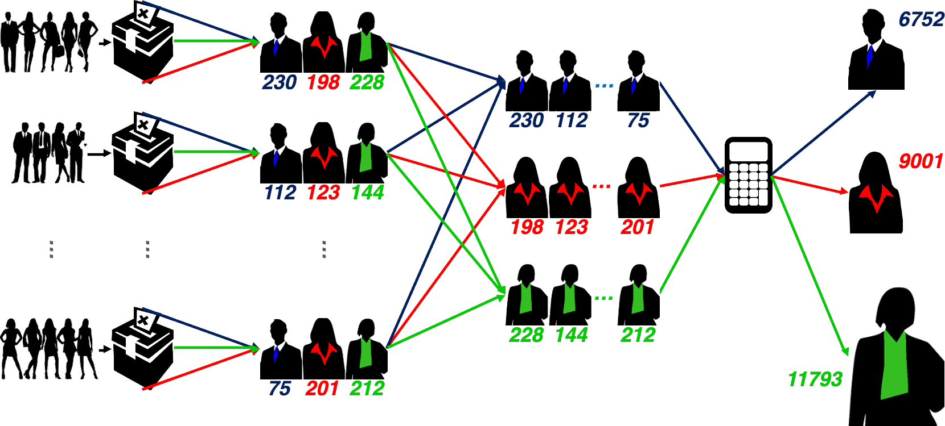

Slide 37
APPROPRIATENESS & TRANSFERABILITY
Data Science methods are not appropriate if:
if one absolutely must use an existing (legacy) datasets instead of an ideal dataset (“it’s the best data we have!”)
the dataset has attributes that usefully predict a value of interest, but which are not available when a prediction is required
if one will attempt to predict class membership using an unsupervised learning algorithm
If data/model is used in other contexts, or to make predictions depending on attributes without data, validating the results is impossible.
Example: can we use a model that predicts mortgage defaulters to also predict car loan defaulters?

Slide 38
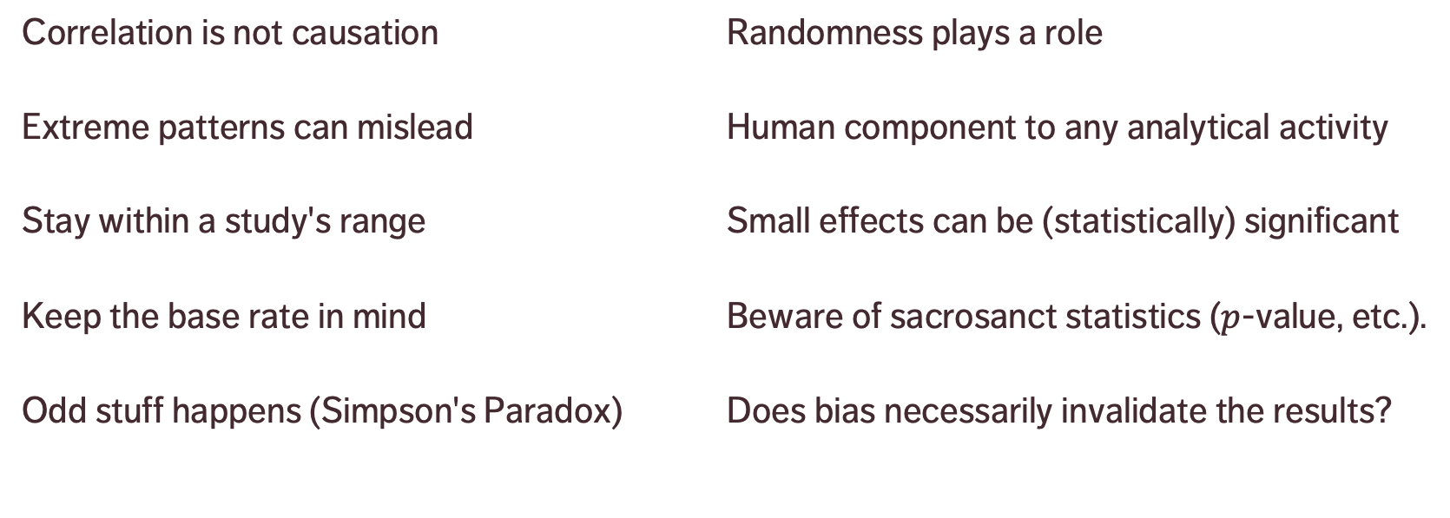
BIASES, FALLACIES & INTERPRETATION
Correlation is not causation
Extreme patterns can mislead
Stay within a study's range
Keep the base rate in mind
Odd stuff happens (Simpson's Paradox)
Randomness plays a role
Human component to any analytical activity
Small effects can be (statistically) significant
Beware of sacrosanct statistics ($p$-value, etc.).
Does bias necessarily invalidate the results?

